Slide 1
TEXEL INDUSTRIES LIMITED. AHMEDABAD, GUJARAT. MANUFACTURERS OF
TEXEL REINFORCED HDPE GEOMEMBRANES
A LASTING SOLUTION FOR LEAKPROOF FARM PONDS
IS: 15351
Lic No. CM/L 7826388

Slide 2
Sources of water
Surface water (41%) is the major source of water for the industries followed by groundwater (35%) and municipal water (24%).
The use of municipal water is limited to industries located in urban/ peri-urban areas (See Figure 1).
A vast majority of industries use surface and groundwater in conjunction with groundwater being relied as a source when surface water availability is on a decline & is impacting the industrial processes.

Slide 3
Today we can see that the Availability of water is becoming an area of concern in Major Parts of the World.
It is a fact that over the past few years, access to water has become difficult and the problem is likely to increase in the coming years.
This is a major worry for Industrial as well as Agricultural Sector .

Slide 4
MAP SHOWING THE GLOBAL PHYSICAL & ECONOMIC WATER SCARCITY

Slide 5
Map below shows the projected water scarcity in 2025 points to a grim situation as it is bound to effect economic as well as the Agricultural growth of the Nation.

Slide 6
REASONS FOR WATER SHORTAGE
Most of the Rainwater goes waste by run off.
Vast amount of water is lost through seepage, especially where the soil is gravelly & porous.
Urban India growing by leaps & bounds has increased the consumption of water.
Mismanagement of Water Resources.
70% of water is lost between the storage & usage points.

Slide 7
ALL THE ABOVE FACTS DEMAND WATER STORAGE & CONSERVATION
QUESTION ARISES HOW TO STORE WATER

Slide 8
SOLUTION
EARTHEN RESERVOIRS /COMMUNITY TANKS/FARM PONDS
LINED WITH TEXEL REINFORCED HDPE GEOMEMBRANE

Slide 9
WHAT IS AN EARTHEN RESERVOIR?
EARTHEN RESERVOIRS are half dug out pits lined with
Texel Reinforced HDPE Geomembrane – Seepage Proof Barrier
for storage of water.
The water from the EARTHEN RESERVOIRS can be used for
Agriculture & IRRIGATION, Industrial operations, & other
related activities.
Sources of water for storage in EARTHEN RESERVOIRS:
Rainwater
Runoff water by streams
Ground water
Water from Canals.

Slide 10
WHAT IS SEEPAGE PROOF BARRIER LINING?
SEEPAGE PROOF BARRIER lining is the process of installing an
impervious POLYMERIC material (REINFORCED HDPE GEOMEMBRANE)
to prevent water loss through Seepage.
Lining with Reinforced HDPE Geomembrane is a revolutionary
concept of water management which dramatically reduces
seepage loss at a reasonable cost.
BENEFITS OF RESERVOIR LINING WITH TEXEL REINFORCED HDPE GEOMEMBRANE.
Lining of Reservoirs improves water availability over a
longer period of time.
Covering bottom sediments with TEXEL REINFORCED HDPE
GEOMEMBRANE prevents submerged weeds & inhibit the
growth of invasive aquatic plants.

Slide 11
BENEFITS OF EARTHEN RESERVOIRS
Economical & effective method of storing water.
COMPLETE PREVENTION of SEEPAGE LOSSES.
Harvesting & storing of rainwater from early monsoons.
It is highly useful in porous soils where water retention
in ponds & water harvesting tanks is minimal.
Eliminates water logging & prevents upward intrusion of
salts into stored water.
Cont….12…

Slide 12
…12…
Useful for the purpose of storage of drinking water,
pisciculture (Fish Farming) & is useful as a supplementary
supply of water for irrigation & Industrial Operations
Prevents soil Erosion.
Utilization of harvested rainwater for Industrial
purpose, Irrigation & during Summer season.
Technique of lining IS also suitable for effluent ponds &
channels to reduce soil & ground water contamination.

Slide 13
INTRODUCTION TO TEXEL INDUSTRIES LIMITED
PIONEER MANUFACTURERS OF
MULTILAYERED PE COMPOSITE MEMBRANES
A COST EFFECTIVE & LASTING SOLUTION FOR LEAK PROOF WATER RESERVOIRS
TEXEL REINFORCED HDPE GEOMEMBRANES

Slide 14
MANUFACTURING & SUPPLY OF TEXEL REINFORCED HDPE GEOMEMBRANE WITH ISI MARK IS : 15351: 2008
PLANNING, DESINGNING & SUPERVISING PRE- INSTALLATION REQUIREMENTS FOR GOOD PERFORMANCE OF GEOMEMBRANE
INSTALLATION OF GEOMEMBRANE INCLUDING LAYING, FIELD JOINING, FIELD TESTING OF GEOMEMBRANE AS PER FIELD QUALITY PLAN.
EXTENDING WARRANTY FOR MATERIAL & INSTALLATION JOBS EXECUTED BY US.
EXPERIENCED INSTALLATION TEAMS TO CARRY OUT PRECISION INSTALLATION.
INVENTORY OF MULTIPLE SETS OF FIELD JOINING & TESTING EQUIPMENTS OF INTERNATIONAL STANDARDS.
SERVICES OFFERED BY TEXEL INDUSTRIES LIMITED

Slide 15
HIGHLIGHTS OF TEXEL INDUSTRIES LIMITED
1ST COMPANY IN INDIA TO OBTAIN ISI LICENCE FOR MARKING UNDER IS :15351:2008
CARRIES ISI MARK AS PER BIS STANDARD IS 15351:2008 LAMINATED HDPE WOVEN FABRIC (GEOMEMBRANE) FOR WATER PROOF LINING.
OFFERS COST EFFECTIVE SOLUTION TO LIQUID CONTAINEMENT & STORAGE WITH ITS CLF RANGE OF REINFORCED HDPE GEOMEMBRANE LINING SYSTEMS
BEEN AT THE FOREFRONT OF DEVELOPMENT, MANUFACTURE & INSTALLATION ON THE GEOMEMBRANE SCENE FOR OVER 20 YEARS.
CLOSELY ASSOCIATED WITH BUREAU OF INDIAN STANDARDS FOR FORMATION OF IS SPECIFICATIONS OF REINFORCED HDPE GEOMEMBRANE.
INSTUMENTAL IN ESTABLISHING GEOMEMBRANE STANDARDS FOR FARM PONDS/ COMMUNITY TANKS UNDER NATIONAL HORTICULTURE MISSION IN THE STATE OF MAHARASHTRA.
SINCE 2005 MORE THAN 6000 FARM PONDS/COMMUNITY TANKS HAVE BEEN LINED WITH REINFORCED HDPE GEOMEMBRANE IN THE STATE OF MAHARASHTRA.
INSTRUMENTAL IN CONSERVATION & STORAGE OF BILLION OF LITRES OF WATER.

Slide 16
WHAT IS GEOMEMBRANE?
GEOMEMBRANES ARE LOW PERMEABILITY SYNTHETIC LINERS USED TO CONTROL FLUID OR GAS MIGRATION WITHIN SOIL, ROCK, EARTH OR ANY OTHER GEOTECHNICAL MATERIAL, AS INTERGRAL PART OF MANMADE PRODUCT, STRUCTURE OR SYSTEM.
TEXEL REINFORCED HDPE GEOMEMBRANE
MANUFACTURERD USING HIGHLY TECHNICAL & CONTROLLED
MANUFACTURING PROCESS.
TIGHTLY WOVEN “GEOTEXTILES” ARE BONDED ON
BOTH SIDES OF GEOMEMBRANE WITH “POLYMER COMPOUND” MAKING A
COMBINED PRODUCT
“Reinforced hdpe geomembrane”

Slide 17
ROLE OF GEOTEXTILES
PROVIDES STRENGTH & CUSHIONING IMPARTING THE MEMBRANE ENHANCED TENSILE, TEAR, PUNCTURE RESISTANCE & HYDROSTATIC PRESSURE RESISTANCE PROPERTIES.
ROLE OF POLYMER COMPOUND LAYERS
ACT AS SECONDARY BARRIERS AS WELL AS BONDING TO THE COMPOSITES IMPARTING COMPLETE IMPERMEABILITY.

Slide 18
APPLICATIONS OF TEXEL REINFORCED GEOMEMBRANE
SPENT WASH LAGOONS & TANKS & BIO- COMPOSTING YARD.
SEEPAGE BARRIER IN AGRICULTURAL & ALLIED FIELDS
TERRACE WATER PROOFING OF BUILDINGS.
BASEMENT, FLOORINGS, BASEMENT RETENTION WALLS AS A SEEPAGE PREVENTION BARRIER.

Slide 19
WHY ONLY TEXEL REINFORCED GEOMEMBRANE ?
Unique 7 Layer construction offers excellent barrier function.
Melt Coating
Woven Reinforcement
Melt coating
Woven Reinforcement
Melt coating
Woven reinforcement
Melt coating
2. Enhanced properties than conventional Film type Liners.
3. High Performance at low installed cost.
4. wide applications in Various Fields.
(Agricultural & Irrigation, Industrial, Environmental)
5. MAHARASHTRA POLLUTION CONTROL BOARD HAS EVALUATED OUR GEOMEMBRANE & APPROVED FOR USE AS SEEPAGE PREVENTION LINING IN SPENT WASH LAGOONS & TANKS & BIO- COMPOSTING YARD.

Slide 20
CRITICAL ISSUES FOR SELECTION OF PLASTIC LINER
CONVENTIONAL LDPE SHEETS EXHIBIT VERY LOW CRITICAL, MECHANICAL & HYDROLIC RESISTANCE PROPERTIES SUCH AS TENSILE STRENGTH, TEAR & PUNCTURE RESISTANCE. (REF. TABLE BELOW)
CRITICAL PROPERTIES | REINFORCED HDPE GEOMEMBRANE 0.5 MM THICK | CONVENTIONAL FILM 1.0 MM THICK | REINFORCED HDPE GEOMEMBRANE 1.0 MM THICK | CONVENTIONAL FILM 1.5 MM
TENSILE (N/mm) | 28 | 28 | 54 | 41
TEAR (N) | 150 | 133 | 250 | 200
PUNCTURE (N) | 400 | 320 | 750 | 480
THE CONSTRUCTION OF LAGOONS, PONDS & LANDFILLS IS DONE MANUALLY UNDER CONTROLLED COST.

Slide 21
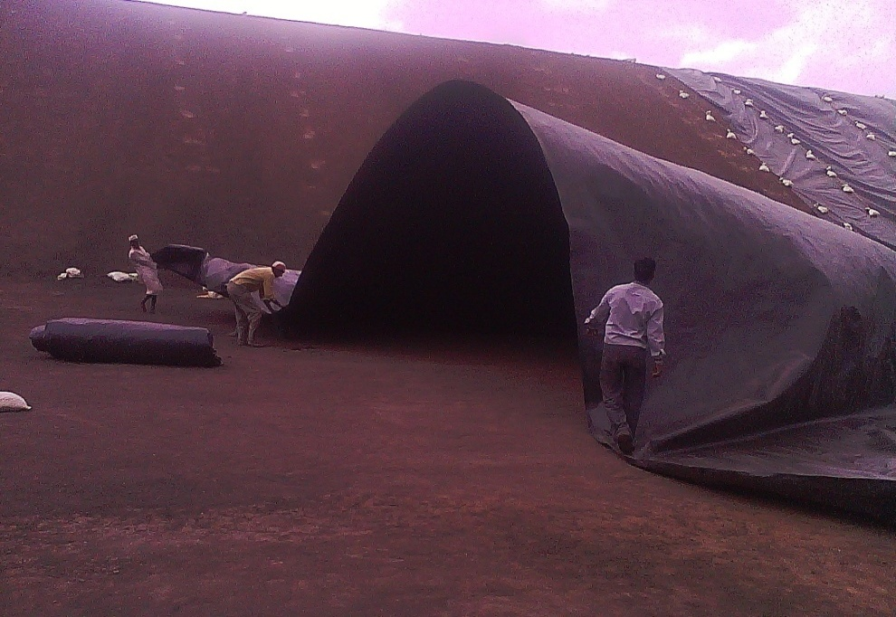
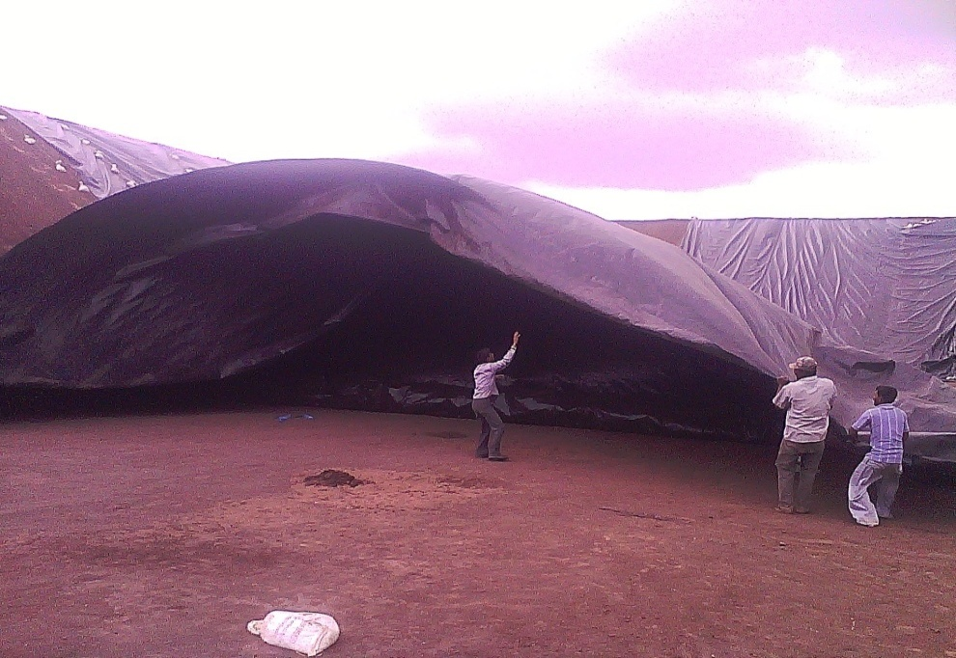
DURING LAYING, FIXING, JOINING & COVERING OF LINING SYSTEMS THE THIN FILMS ARE SUBJECT TO VARIOUS KIND OF ABUSES. HENCE THERE IS A TENDENCY OF FILM TYPE LINING MATERIAL GETTING DAMAGED.
3. However, this factor is not known to the contractor and therefore the lining system which has been put in place is already having ruptures and pinholes even before it is operational.
The photographs below show the membrane carried away by the wind. At such a high wind velocity LDPE/Conventional Films tear easily. Geomembrane has Good Tensile Strength & high tear resistance & hence could withstand high wind pressure without getting damaged.

Slide 22
PROPERTIES THAT GIVE GOOD PERFORMANCE OF REINFORCED HDPE GEOMEMBRANES
Property | Effects on Performance of Geomembrane
Puncture resistance | Stops Geomembrane from puncturing easily due to poor sub grade of ponds.
Tear Strength | Prevents tearing of Geomembranes due to stresses created during installation.
Tensile Strength | Again prevents tearing of Geomembranes due to stresses created during installation.
Burst Strength | Prevents bursting of Geomembrane due to effect of protrusions in sub grade of the pond.
Seam Strength | Ensures adequate strength of seam to prevent leakage at seams (Seaming is done to increase the dimensions of Geomembrane).

Slide 23
Carbon Black Content Carbon Black Dispersion | Provides adequate resistance to ultra violet rays present in sunlight which breaks down the molecules in a polymer. Adequate carbon black dispersion ensures longer life of Geomembrane.
Hydrostatic Resistance | This is the most important property to measure the suitability of the Geomembrane for irrigation pond. High Hydrostatic Resistance will provide stability against seepage of water which exerts high pressure on Geomembrane.
Creep Resistance | High Creep Resistance Resists Deformation under sustained load.
Excellent Thermal & Photo Oxidation Resistance Property | Delays Degradation thereby enhances performance life of Geomembrane

Slide 24
Comparison of properties of HDPE Reinforced Geomembrane with ISI mark IS:15351:2008 & HDPE, LDPE FILM
PROPERTY | TEST METHOD ASTM CODED | UNIT | REINFORCED HDPE GEOMEMBRANE 0.5MM (500 MICRONS) VALUES | HDPE FILM 0.5MM (500MICRONS) VALUES | LDPE FILM 0.5mm (500 MICRONS) VALUES
Material Density | 1505 | Gm/CC | 0.939 | 0.940 | 0.920
Breaking Strength | 6093, Type IV | N/mm | 28 | 14 | 12
Elongation | 638 | % | 22 + for both MD & TD | 700 | 610
Puncture Resistance | 4833 | N | 491 | 176 | 120
Tear Resistance | 1004 | N | 120 | 73 | 50
Bursting strength | 751 | Kg/cm² | 8.5 | 4.3 | 4
Hydro Static Resistance | 751 | Kg/cm² | No through leakage upto 15kg/cm². | Sample Bursted at 3kg/cm². | Sample Bursted at 2kg/cm².
Impact failure load at 1524 mm height | 1424 | Gf | Passed more than 2000 gf Load | Load passed at 585 gf. | Load passed at 555 gf.

Slide 25
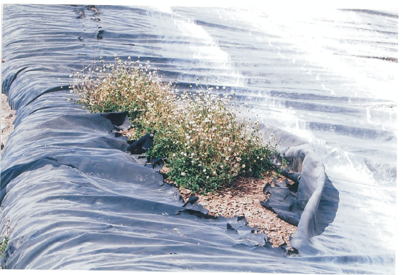
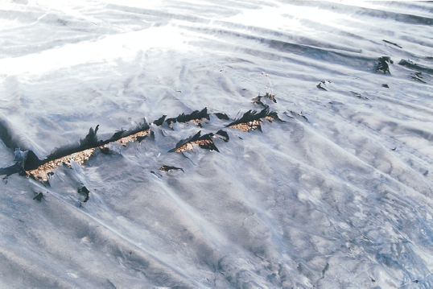
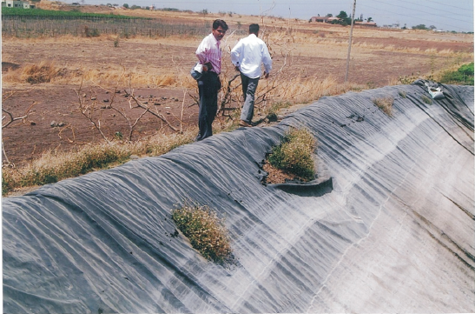
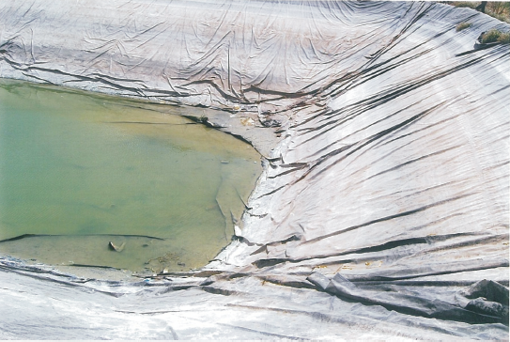

Slide 26
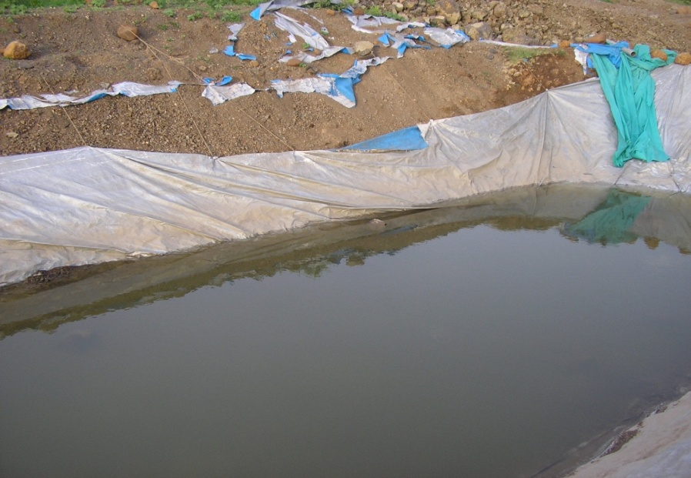
Failure of Farm ponds due to use of poor quality plastic sheets
TO OVERCOME ALL THE ABOVE NEGATIVES, TEXEL REINFORCED HDPE GEOMEMBRANE CLF RANGE WAS DESIGNED.

Slide 27
CONSTRUCTION OF EARTHEN RESERVOIRS & INSTALLATION PROCESS OF GEOMEMBRANE

Slide 28
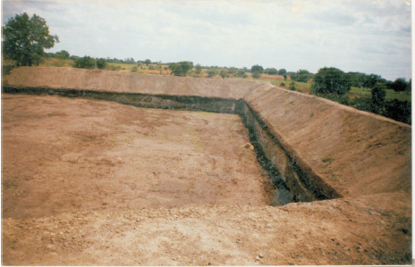
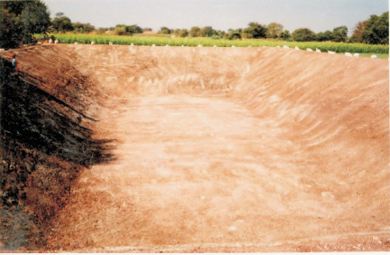
Excavation & Compaction of Earthen Reservoir

Slide 29
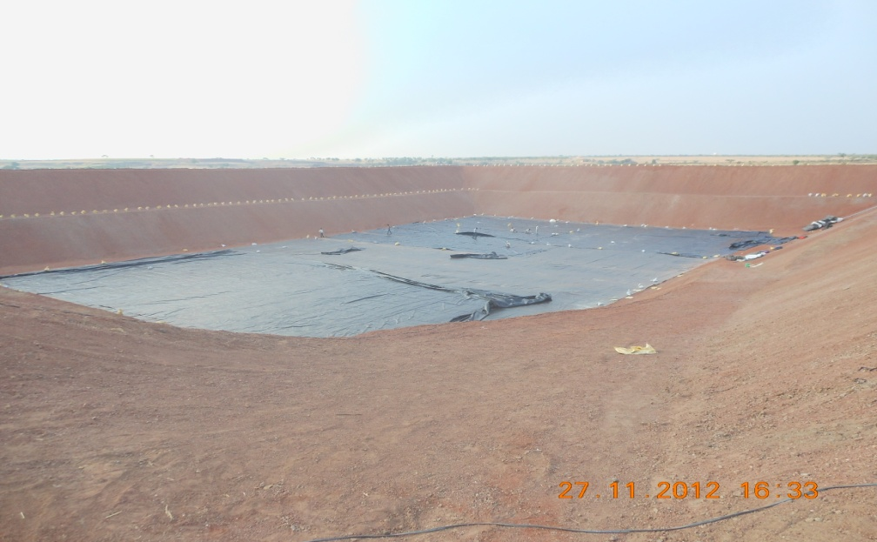
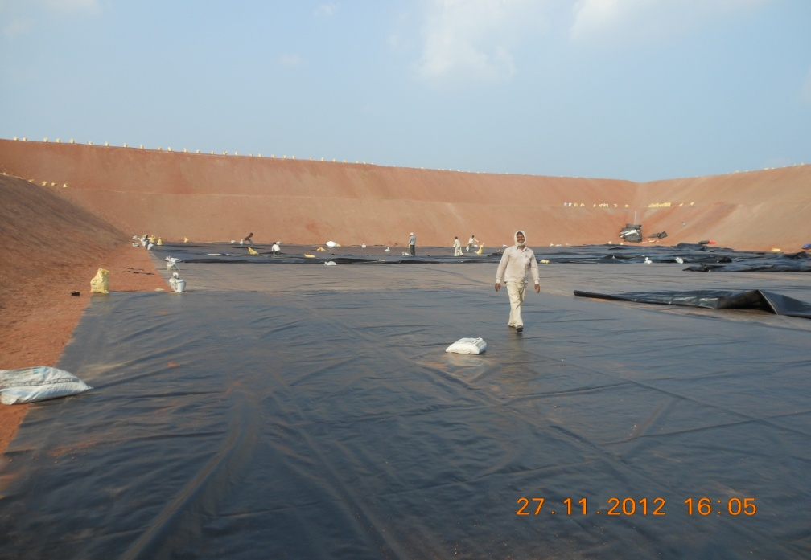
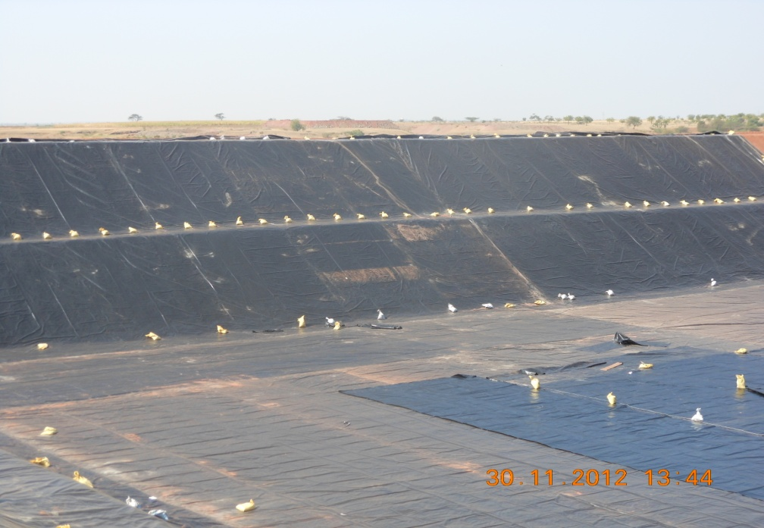
Geomembrane Installation work IN PROGRESS

Slide 30
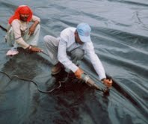
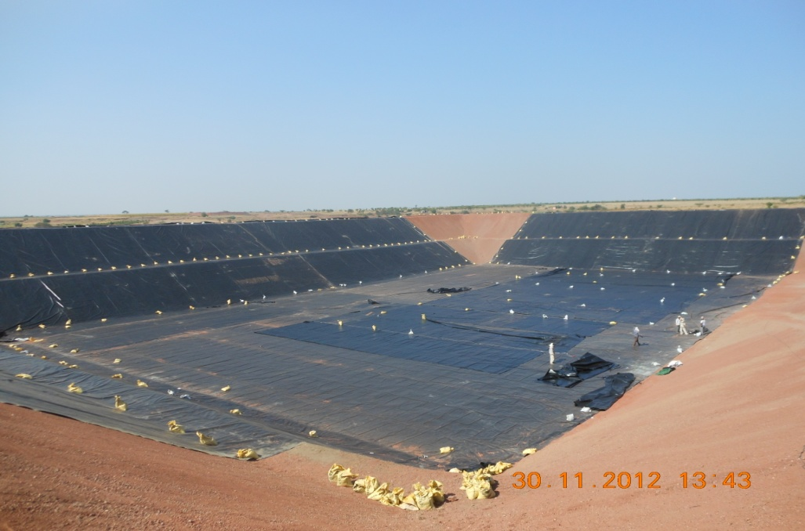
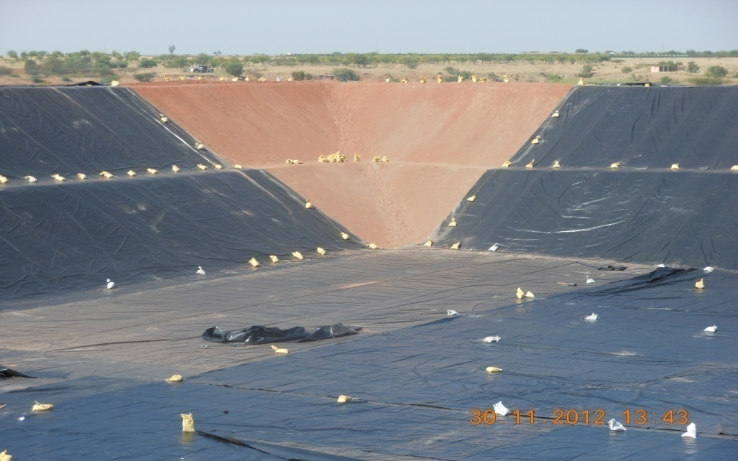

Slide 31
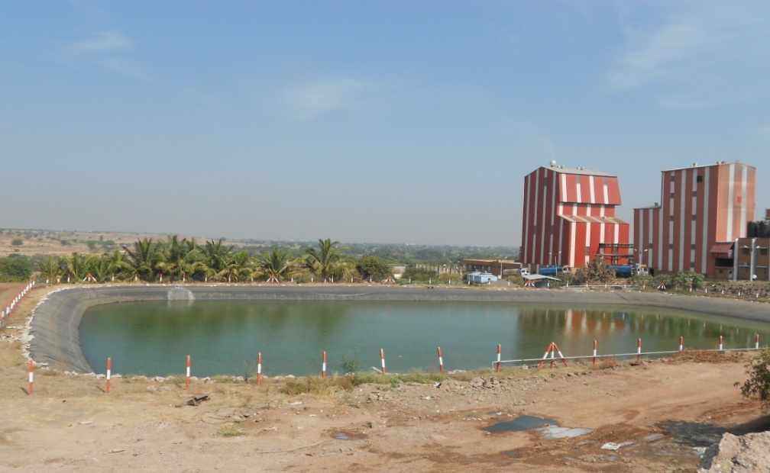
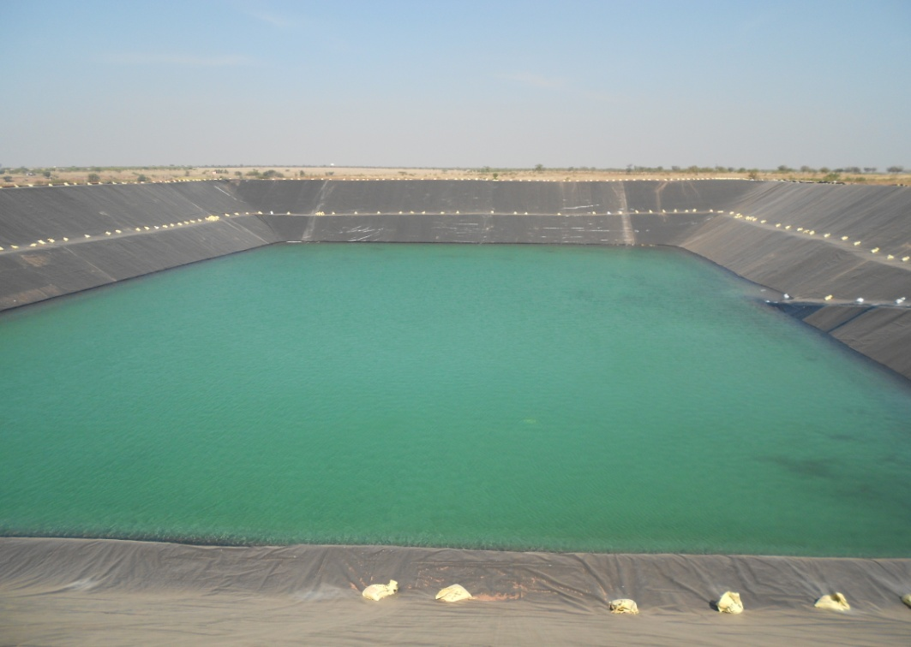
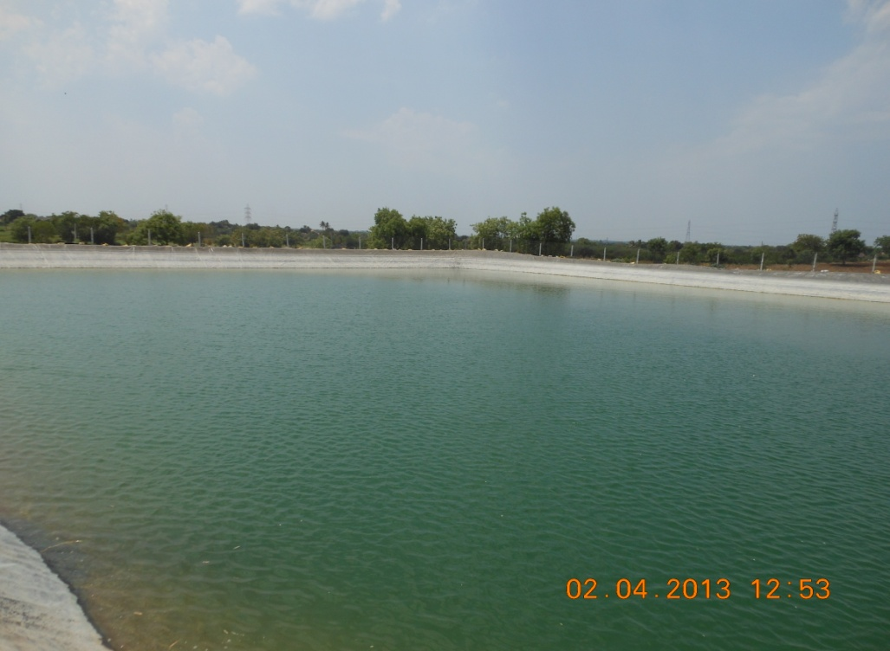
Earthen Reservoir lined with Texel Geomembrane

Slide 32
ADDITIONAL COVER OVER THE GEOMEMBRANE
IN ORDER TO ENHANCE THE LIFE OF GEOMEMBRANE, A PROTECTIVE COVER OVER THE GEOMEMBRANE CAN BE LAID.
THE PROTECTIVE COVERS CAN BE ANY OF THE FOLLOWING TYPES:
PAVER BLOCKS COVER
STONE PITCHING COVER
PRECAST TILES COVER
CEMENT IMPREGNATED GEOTEXTILE COVER.

Slide 33
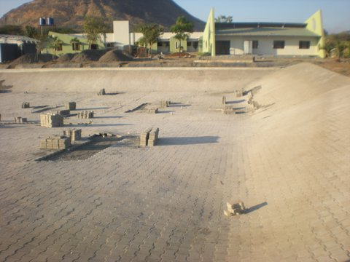
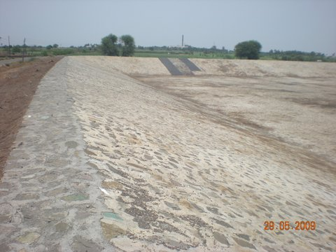
PAVER BLOCKS COVER OVER THE GEOMEMBRANE
STONE PITCHING COVER OVER THE GEOMEMBRANE

Slide 34
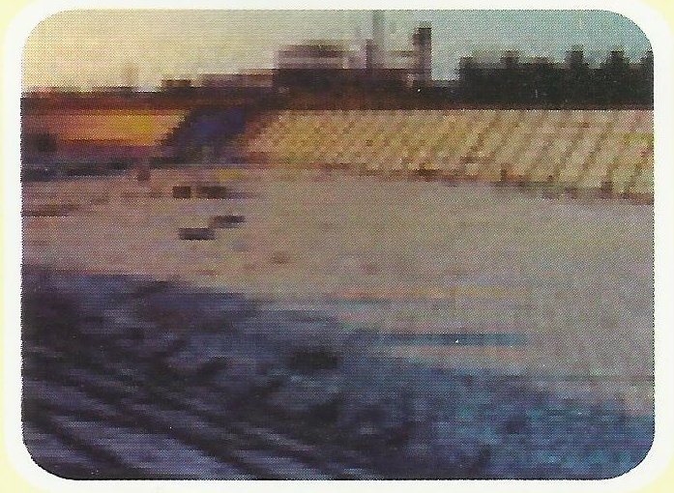
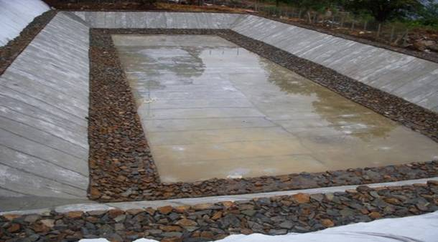
PRECAST TILES COVER OVER THE GEOMEMBRANE
CEMENT IMPREGNATED COVER OVER THE GEOMEMBRANE

Slide 35
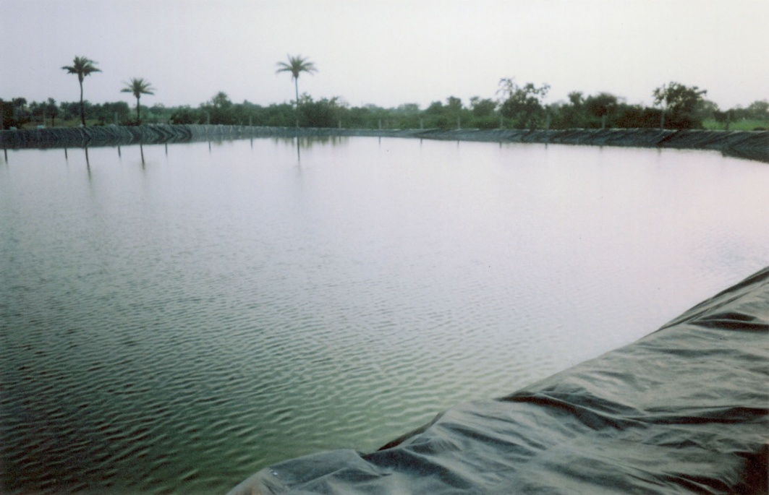
Water stored in earthen reservoir between the mountains
Water Filled earthen reservoir

Slide 36
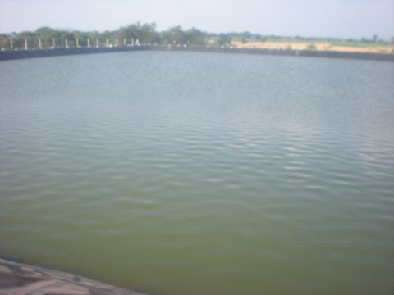
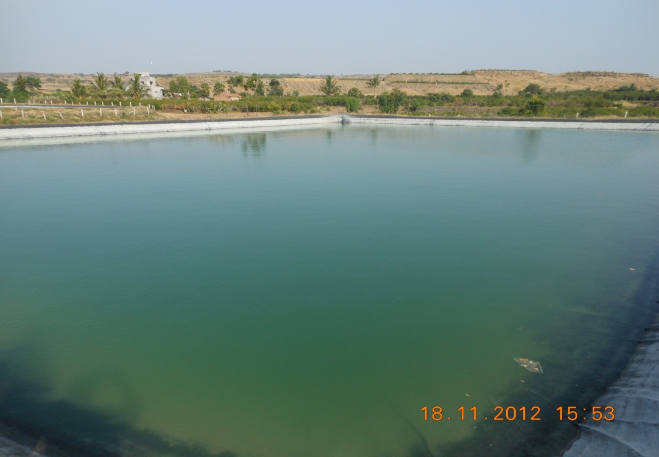
Water Filled earthen reservoir
Water filled Reservoir with Fencing all Around

Slide 37
VARIOUS SIZES OF FARM PONDS & THEIR CAPACITY TO STORE WATER
SIZE OF POND (L X B X H) IN METERS | SLOPE RATIO | CAPACITY OF TANKS IN LITRES | CAPACITY OF TANK M³ | GEOMEMBRANE REQUIRED IN M²
15 X 15 X 3 | 1:1 | 839000 | 839 | 708
20 X 15 X 3 | 1:1 | 1196000 | 1196 | 841
20 X 20 X 3 | 1:1 | 1790000 | 1790 | 999
25 X 20 X 3 | 1:1 | 2322000 | 2322 | 1157
25 X 25 X 3 | 1:1 | 2922000 | 2922 | 1322
30 X 25 X 3 | 1:1 | 3522000 | 3522 | 1513
30 X 30 X 3 | 1:1 | 4247000 | 4247 | 1730
50 X 50 X 3 | 1:1 | 6000000 | 6000 | 3795

Slide 38
SUCCESS STORIES OF FARMERS OF DISTRICT AHMEDNAGAR, MAHARASHTRA

Slide 39
SHRI. MADHAV PAWAR
A/P NILWANDE, TAL SANGAMNER DIST. AHMEDNAGAR, MAHARASHTRA.
SIZE OF THE FARM POND CONSTRUCTED: 50 M X 54 M X 6M (LXWXH)
YEAR OF SUPPLY OF GEOMEMBRANE : 2007
GEOMEMBRANE REQ. : 3985 SQM
STORAGE CAPACITY: 1.5 CRORE
LITRES APPROX.
LAND AREA BENEFITTED BY FARM POND: TOTAL 8 HECTARES
(6 HECTARES FOR HORTICULTURE CULTIVATION)
TYPE OF PLANTATION CROPS: POMOGRANATE
Shri. Madhav Pawar. At Post – Nelwande, Tal. Sangamner, Dist. Ahmednagar.

Slide 40
SHRI. MADHAV PAWAR
DAILY CONSUMPTION OF WATER: 2.5 LAKH LITRES
SOURCE OF WATER TO FILL THE FARM POND: WELL, BORE WELL & CHECK DAM
DURING SUMMER: APPROX 1000 TANKERS/SEASON
(1 TANKER COST RS. 900/- APPROX)
ADDITIONAL BENEFITS & GAINS DUE TO FARM POND:
FINANCIALSTATUS IMPROVED AS THERE WAS CONTINOUS YEILD OF POMOGRANATE DUE TO FARM PONDS.
FARM POND WITH REINFORCED HDPE GEOMEMBRANE WITH ISI MARK IS : 15351 : 2008, TYPE – II 500 MICRONS

Slide 41
SHRI. MADHAV PAWAR
OBSERVATIONS OF THE PERSONAL MEETING WITH THE FARMER ON 21ST NOV, 2012 AT THE FARMERS FARM
HE RECEIVED A SUBSIDY UNDER NHM SCHEME FOR 5 HECTARES LAND HOLDING, BALANCE HE HAS TAKEN LOAN AT 20% PER ANNUM.
FROM A MEAGRE WAGE OF RS. 100/- PER DAY AS A FARM WORKER TODAY HE HAS OWN BUNGALOW, 2 TRACTORS & 4 CARS.
SHRI MADHAV PAWAR, BUNGALOW A/P NILWNDE TAL. SANGAMNER, DIST. AHMEDNAGAR.

Slide 42
SHRI. MADHAV PAWAR
OTHER ACHIVEMENTS OF
SHRI MADHAV PAWAR
HE IS THE AWARD WINNER AS “KRUSHI BHUSHAN” FROM GOVT. OF MAHARASHTRA & MANY MORE AWARDS.
HE IS THE CHAIRMAN OF POMOGRANATE GROWERS ASSOCIATION IN NILWANDE VILLAGE.
POMOGRANATE CULTIVATION AT SHRI MADHAV PAWAR’S FARM AT NILWANDE

Slide 43
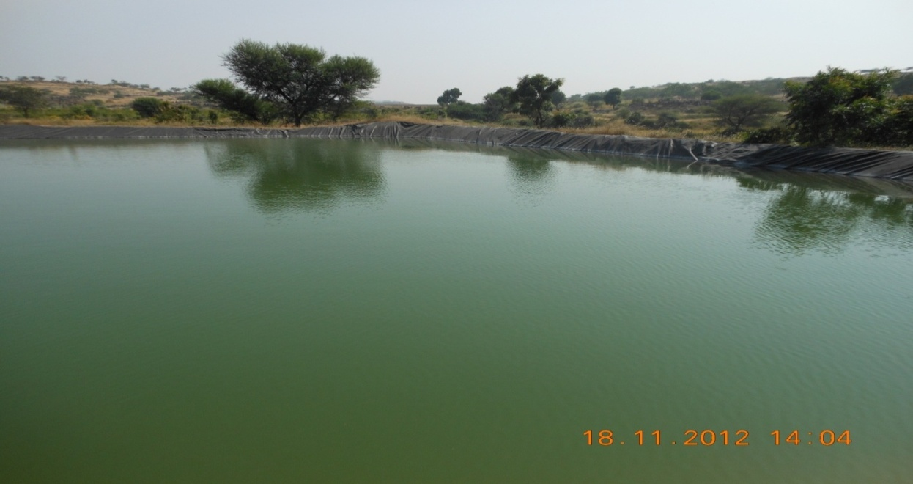
SHRI. MADHAV PAWAR
FARM PONDS WITH REINFORCED HDPE GEOMEMBRANE WITH ISI
MARK IS : 15351 : 2008, TYPE – II 500 MICRONS
Shri. Madhav Pawar. At Post – Nelwande, Tal. Sangamner, Dist. Ahmednagar.

Slide 44
SHRI. NANASAHEB KHERE
A/P NILWANDE, TAL SANGAMNER DIST. AHMEDNAGAR, MAHARASHTRA.
SIZE OF THE FARM POND CONSTRUCTED: 30 M X 30 M X 4M (LXWXH)
YEAR OF SUPPLY OF GEOMEMBRANE : 2007
GEOMEMBRANE REQ. : 1345 SQM
STORAGE CAPACITY: 38 LAKH
LITRES APPROX.
LAND AREA CULTIVATED UNDER FARM POND: TOTAL 3.6 HECTARES
FOR HORTICULTURE CULTIVATION
TYPE OF PLANTATION CROPS: POMOGRANATE
Shri. NANASAHEB KHERE . At Post – Nelwande, Tal. Sangamner, Dist. Ahmednagar.

Slide 45
SHRI. NANASAHEB KHERE
DAILY CONSUMPTION OF WATER: 1.5 LAKH LITRES
SOURCE OF WATER TO FILL THE FARM POND: WELL, BORE WELL & CHECK DAM
DURING SUMMER: APPROX 400 -500 TANKERS/SEASON
(1 TANKER COST RS. 900/- APPROX)
ADDITIONAL BENEFITS & GAINS DUE TO FARM POND:
EVERY YEAR 2 HECTARES HORTICULTURE PLANTATION INCREASED DUE TO FARM POND.
FARM POND WITH REINFORCED HDPE GEOMEMBRANE WITH ISI MARK IS : 15351 : 2008, TYPE – II 500 MICRONS

Slide 46
SHRI. NANASAHEB KHERE
OBSERVATIONS OF THE PERSONAL MEETING WITH THE FARMER ON 21ST NOV, 2012 AT THE FARMERS FARM
HIS FINANCIAL STATUS HAS IMPROVED.
BUYING ADDITIONAL AGRICULTURAL LAND EVERY YEAR.
SHRI NANASAHEB KHERE. FARM POND, A/P NILWNDE TAL. SANGAMNER, DIST. AHMEDNAGAR.

Slide 47
SHRI. NANASAHEB KHERE
FARM POND WITH REINFORCED HDPE GEOMEMBRANE WITH ISI MARK IS : 15351 : 2008, TYPE – II 500 MICRONS
Shri. Nanasaheb KHere. FARM POND At Post – Nelwande, Tal. Sangamner, Dist. Ahmednagar.

Slide 48
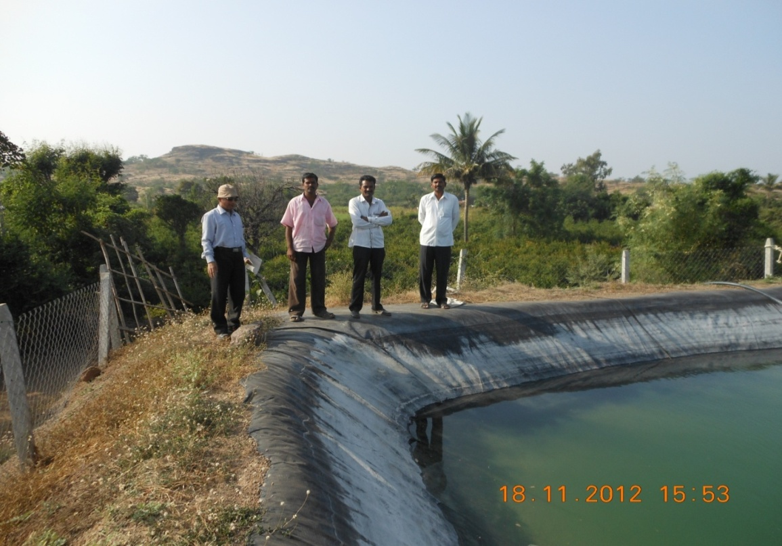
SHRI. ASHOK PAWAR
A/P NILWANDE, TAL SANGAMNER DIST. AHMEDNAGAR, MAHARASHTRA.
SIZE OF THE FARM POND CONSTRUCTED: 34 M X 34 M X 5M (LXWXH)
YEAR OF SUPPLY OF GEOMEMBRANE : 2007
GEOMEMBRANE REQ. : 2000 SQM
STORAGE CAPACITY: 60 LAKH
LITRES APPROX.
LAND AREA CULTIVATED UNDER FARM POND: TOTAL 8 HECTARES
4 HECTARES FOR HORTICULTURE CULTIVATION.
TYPE OF PLANTATION CROPS: POMOGRANATE
Shri. ASHOK PAWAR . At Post – Nelwande, Tal. Sangamner, Dist. Ahmednagar.

Slide 49
SHRI. ASHOK PAWAR
DAILY CONSUMPTION OF WATER: 1.60 LAKH LITRES
SOURCE OF WATER TO FILL THE FARM POND: WELL, BORE WELL & CHECK DAM
DURING SUMMER: APPROX 1500 TANKERS/SEASON
(1 TANKER COST RS. 900/- APPROX)
ADDITIONAL BENEFITS & GAINS DUE TO FARM POND:
EVERY YEAR 2 HECTARES HORTICULTURE PLANTATION INCREASED DUE TO FARM POND.
FARM POND WITH REINFORCED HDPE GEOMEMBRANE WITH ISI MARK IS : 15351 : 2008, TYPE – II 500 MICRONS
HIS FINANCIAL STATUS HAS IMPROVED & HAS PURCHASED 6 HECTARES OF ADDITIONAL LAND.

Slide 50
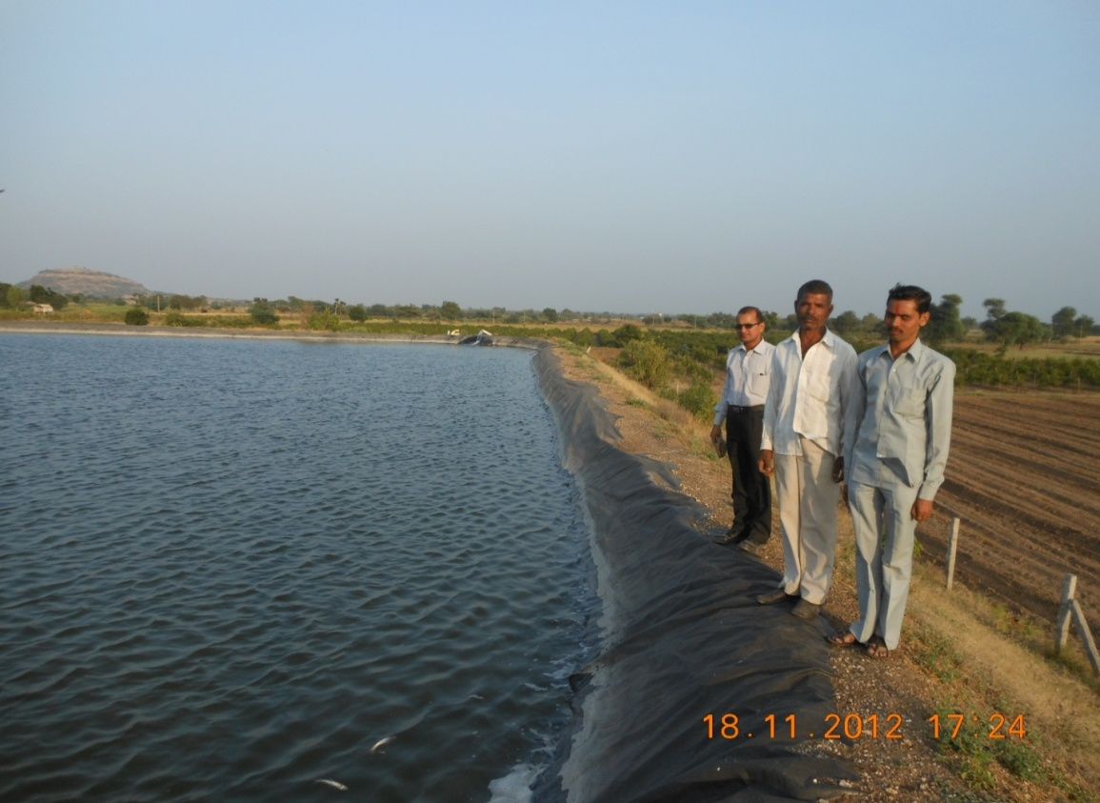
SHRI. KISAN DENGALE
A/P NIMGAON JALI, TAL SANGAMNER DIST. AHMEDNAGAR, MAHARASHTRA.
SIZE OF THE FARM POND CONSTRUCTED: 44 M X 44 M X 5.6M (LXWXH)
YEAR OF SUPPLY OF GEOMEMBRANE : 2007
GEOMEMBRANE REQ. : 3249 SQM
STORAGE CAPACITY: 1.15 CRORE
LITRES APPROX.
LAND AREA CULTIVATED UNDER FARM POND: TOTAL 4.8 HECTARES
3.6 HECTARES FOR HORTICULTURE CULTIVATION.
TYPE OF PLANTATION CROPS: 3.6 HECTARES POMOGRANATE
1.2 HECTARES JOWAR ETC.
Shri. KISAN DENGALE. At Post – NIMGAON JALI, Tal. Sangamner, Dist. Ahmednagar.

Slide 51
SHRI. KISAN DENGALE
DAILY CONSUMPTION OF WATER: 1.5 LAKH LITRES
SOURCE OF WATER TO FILL THE FARM POND: WELL & CANAL.
DURING SUMMER: CANAL
ADDITIONAL BENEFITS & GAINS DUE TO FARM POND:
4 HECTARES HORTICULTURE PLANTATION WAS DONE.
FARM POND WITH REINFORCED HDPE GEOMEMBRANE WITH ISI MARK IS : 15351 : 2008, TYPE – II 500 MICRONS
HIS FINANCIAL STATUS HAS IMPROVED & HAS PURCHASED 6 HECTARES OF ADDITIONAL LAND.

Slide 52
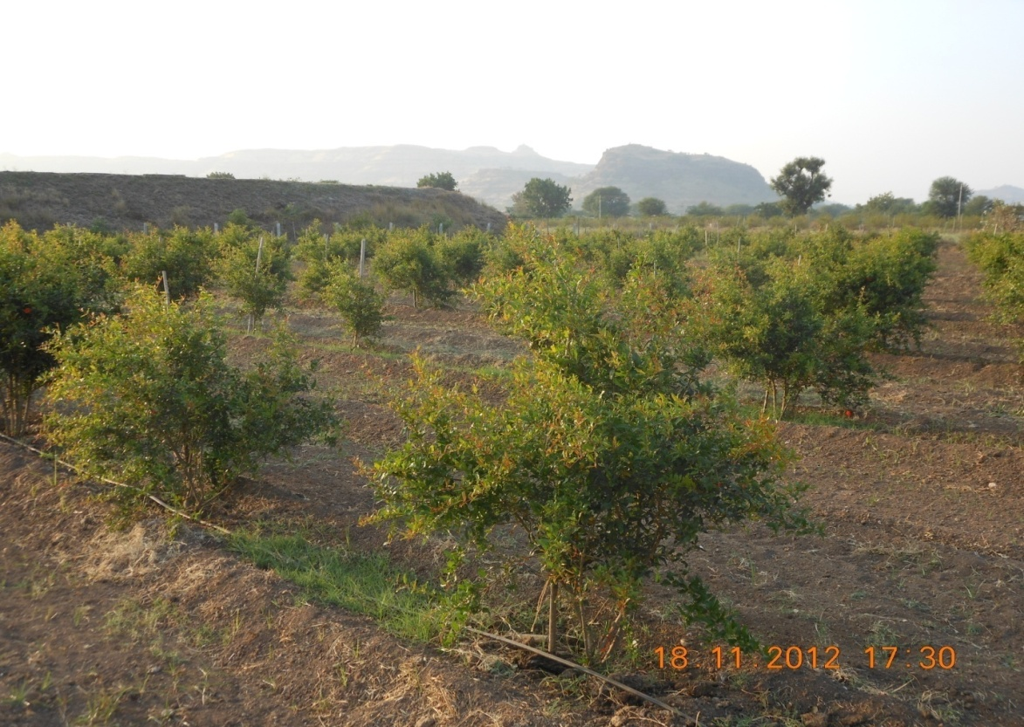
SHRI. KISAN DENGALE
OBSERVATIONS OF THE PERSONAL MEETING WITH THE FARMER ON 21ST NOV, 2012 AT THE FARMERS FARM
HIS 4.8 HECTARES OF LAND HOLDING WAS LYING UNUSED DUE TO NON AVAILABILITY OF WATER.
AFTER CONSTRUCTION OF FARM POND IN 2007 HE DID PLANTATION OF POMOGRANATE ON 3.6 HECTARES LAND & ON BALANCE 1.2 HECTARES JOWAR ETC. WAS CULTIVATED.
SHRI KISAN DENGALE. POMOGRANATE CULTIVATION, A/P NIMGAON JALI, TAL. SANGAMNER,
DIST. AHMEDNAGAR.

Slide 53
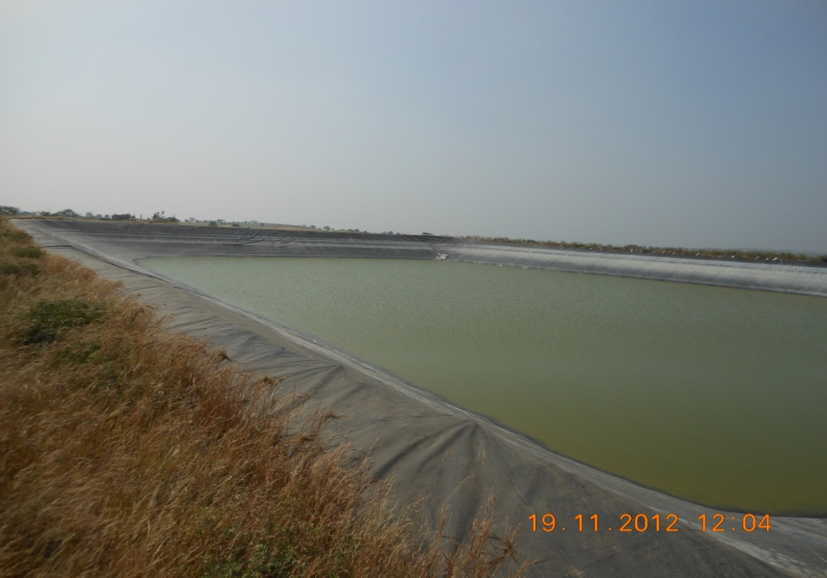
SHRI. HAJI SHOKAT EBRAHIM TAMBOLI
A/P BHATODI, TAL & DIST. AHMEDNAGAR, MAHARASHTRA.
SIZE OF THE FARM POND CONSTRUCTED: 98 M X 98 M X 9M (LXWXH)
YEAR OF SUPPLY OF GEOMEMBRANE : 2008
GEOMEMBRANE REQ. : 9291 SQM
STORAGE CAPACITY: 6.15 CRORE
LITRES APPROX.
LAND AREA CULTIVATED UNDER FARM POND: TOTAL 50 HECTARES
30 HECTARES FOR HORTICULTURE CULTIVATION.
TYPE OF PLANTATION CROPS: 20 HECTARES POMOGRANATE,
10 HECTARES MANGO. ETC.
Shri. HAJI SHOKAT EBRAHIM TAMBOLI. FARM POND
A/P – BHATODI, Tal. & Dist. Ahmednagar.

Slide 54
SHRI. HAJI SHOKAT EBRAHIM TAMBOLI
DAILY CONSUMPTION OF WATER: 10 LAKH LITRES
SOURCE OF WATER TO FILL THE FARM POND: WELL , BORE WELL & TANKER.
DURING SUMMER: BORE WELL & TANKER.
ADDITIONAL BENEFITS & GAINS DUE TO FARM POND:
EVERY YEAR 2 HECTARES HORTICULTURE PLANTATION IS INCREASED.
FARM POND WITH REINFORCED HDPE GEOMEMBRANE WITH ISI MARK IS : 15351 : 2008, TYPE – II 500 MICRONS
HIS FINANCIAL STATUS HAS IMPROVED & HAS NO ISSUES WITH THE PERFORMANCE OF REINFORCED HDPE GEOMEMBRANE WITH ISI MARK IS 15351:2008.

Slide 55
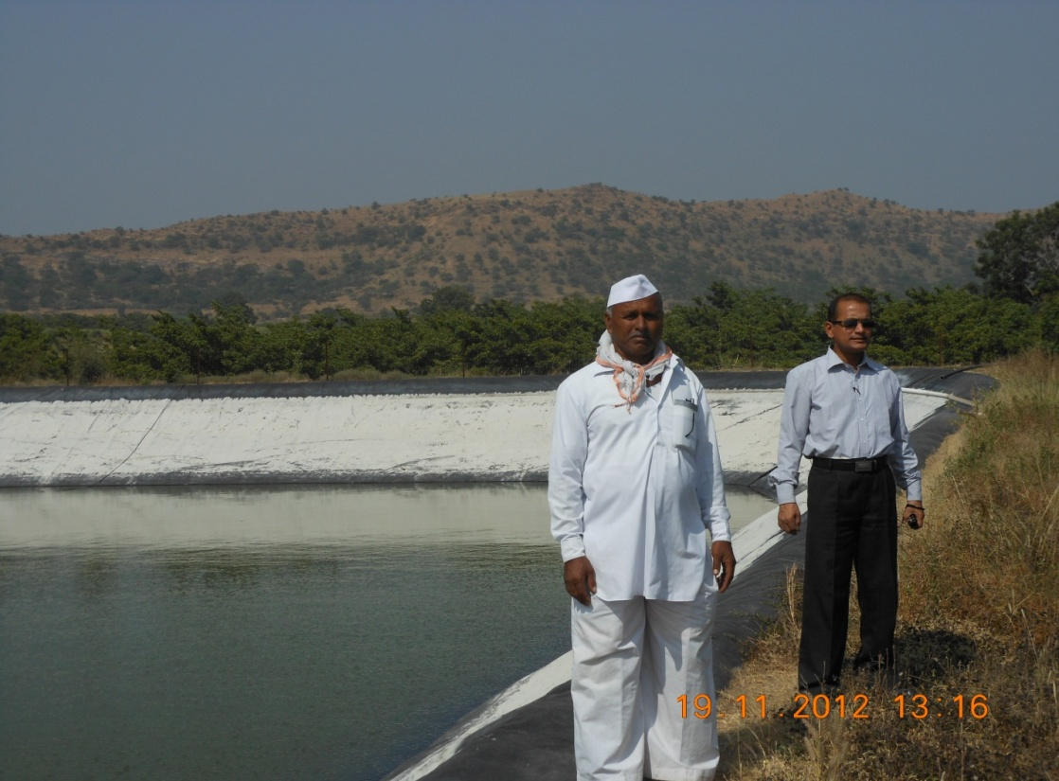
SHRI. GOVARDHAN KADAM
AT MANJARSUMBHA, POST JEUR TAL & DIST. AHMEDNAGAR, MAHARASHTRA.
SIZE OF THE FARM POND CONSTRUCTED: 52 M X 52 M X 6M (LXWXH)
YEAR OF SUPPLY OF GEOMEMBRANE : 2007
GEOMEMBRANE REQ. : 3600 SQM
STORAGE CAPACITY: 1.75 CRORE
LITRES APPROX.
LAND AREA CULTIVATED UNDER FARM POND: TOTAL 10 HECTARES
HORTICULTURE CULTIVATION.
TYPE OF PLANTATION CROPS: POMOGRANATE, CHIKOO, ORANGE & MANGO – 5 HECTARES.
Shri. GOVARDHAN KADAM. FARM POND
AT MANJARSUMBHA, POST JEUR Tal. & Dist. Ahmednagar.

Slide 56
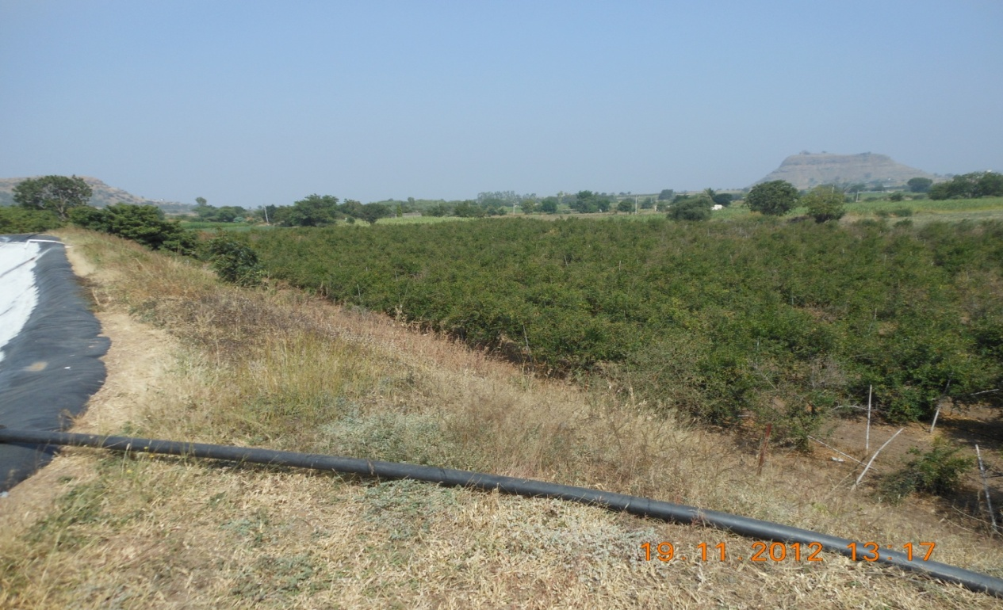
SHRI. GOVARDHAN KADAM
DAILY CONSUMPTION OF WATER: 2 LAKH LITRES
SOURCE OF WATER TO FILL THE FARM POND: WELL & BORE WELL.
DURING SUMMER: TANKER.
ADDITIONAL BENEFITS & GAINS DUE TO FARM POND:
HORTICULTURE PLANTATION INCREASED.
POMOGRANATE CULTIVATION AT SHRI. GOVARDHAN KADAM’S FARM AT MANJARSUMBHA, POST JEUR Tal. & Dist. Ahmednagar

Slide 57
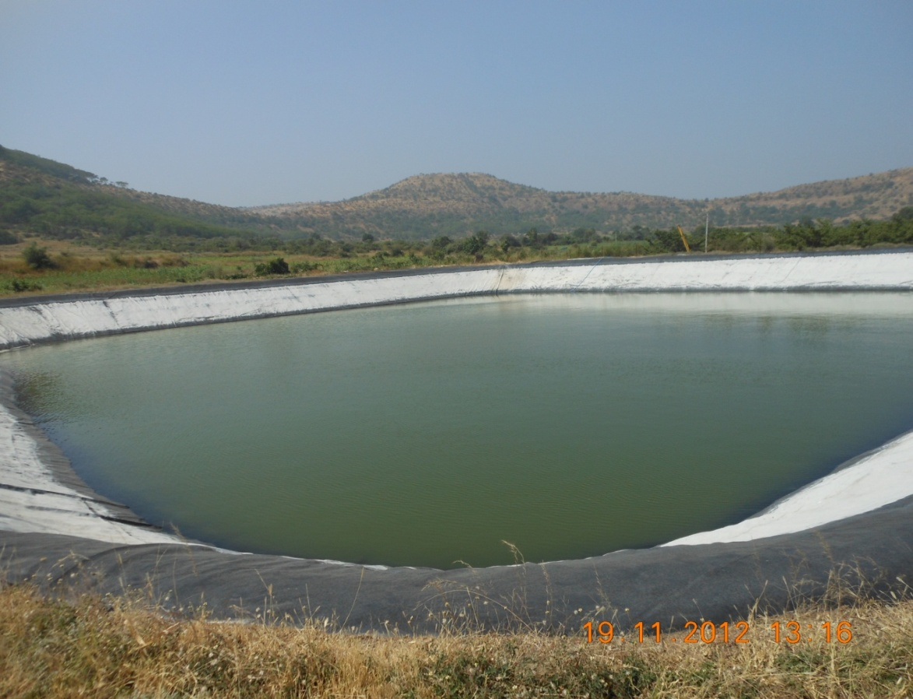
SHRI. GOVARDHAN KADAM
OBSERVATIONS OF THE PERSONAL MEETING WITH THE FARMER ON 21ST NOV, 2012 AT THE FARMERS FARM
AFTER FEBRUARY EVERY YEAR THERE WAS NO WATER AVAILABLE IN WELLS & BOREWELLS, THERE WOULD BE NO WATER FOR HIS HORTICULTURE CULTIVATION.
AFTER CONSTRUCTION OF FARM POND IN 2007 HIS HORTICULTURE CULTIVATION HAS INCREASED.
HIS FINANCIAL STATUS HAS IMPROVED & HAS PURCHASED ADDITIONAL LAND, HAS DONE NEW DEVELOPMENTS IN OLD LAND.
SHRI GOVARDHAN KADAM’S FARM POND , AT MANJARSUMBHA, POST JEUR Tal. & Dist. Ahmednagar

Slide 58
TEXEL REINFORCED HDPE GEOMEMBRANE HAS QUALIFIED THE VIGOROUS EVALUATIONS, BEFORE RECOMMENDED FOR USE BY FOLLOWING CONSULTANTS.
TOYO ENGINEERING INDIA LTD.
TATA CONSULTING ENGINEERS
GEOSCIENCE INDIA CO. PVT. LTD.
LURGI INDIA CO. PVT. LTD.
SMPS CONSULTANTS – AHMEDABAD
MAHARASHTRA JEEVAN PRADHIKARAN
KIRLOSKAR CONSULTANTS LTD.
M.N. DASTUR & CO. LTD. CHENNAI.
G.C.OAK & ASSOCIATES MUMBAI.
STUP CONSULTANTS P. LTD. BANGALORE.
CICON KALYAN.
U.P.JAL NIGAM LUCKNOW.
KVAERNER POWER GAS (I) LTD.
NTPC LTD. ENGG. DIVISION.
CONSULTING ENGINEERS SERVICES (INDIA) PVT. LTD.

Slide 59
LIST OF OUR PRESTIGIOUS CLIENTS
APPLICATION | NAME OF THE OWNER
BALANCING RESERVOIR | Southern Iron & Steel Co. Ltd. (Pig Iron Project). Salem (Tamil Nadu).
BALANCING RESERVOIR | Steel Authority of India Ltd (Salem Steel Plant ) Phase III (TAMIL Nadu)
UNDERGROUND FIRE FIGHTING TANK | Aegis Chemical Inds. Ltd, Trombay, Mumbai. (Maharashtra.)
SOLAR EVAPORATION POND | Orchid Chemicals & Pharmaceuticals Ltd Chennai. (Tamil Nadu)
CONSTRUCTION OF WATER SUMP | Reliance Industrial Infrastructure Ltd, Jamnagar (Gujarat).
WATER RESERVOIR | Terra Agro Technologies Ltd, Udumalpet.(TAMIL NADU)
RAIN WATER STORAGE POND | Kirloskar Toyoda Textile Machinery Ltd, Bangalore.(Karnataka)
SLUDGE TANK | RPG Group - SAE India Ltd Deori, Jabalpur.(M.P)
ASH POND/ RECTIFICATION OF CLEAR WATER RESERVOIR | Hindalco Industries Ltd, Renukoot.(U.P).
WATER RESERVOIR | Mukund Ltd. Hospet Division.
LEACHING PAD | HINDUSTAN ZINC LIMITED, JAGPURA GOLD PROJECT
WATER RESERVOIR | ELF GAS INDIA LIMITED MANAGLORE, KARNATAKA.

Slide 62
FARM POND CONSTRUCTED AT Mirtola Sri Thakurji Trust Almora Uttar Pradesh Since 1990
IT CAN BE CONCLUDED HERE THAT, Our Texel Reinforced HDPE Geomembrane has proved it’s utility by performing beyond expectations.

Slide 63
THANK YOU!
Manufacturers
TEXEL INDUSTRIES LIMITED
FACTORY: BLOCK NO. 2106, SANTEJ KHATRAJ ROAD, NEAR SHAH STEEL, VILLAGE SANTEJ – 382 721 TAL. KALOL. (N.G.) DISTGANDHINAGAR, GUJARAT, INDIA.
EMAIL: tilstj2004@yahoo.com ; bhupen44@hotmail.com
Authorized Installers
RISHA INFRASTRUCTURES
3/A, 14 – C, 1ST FLOOR, PANNALAL SILK MILLS ESTATE, LBS MARG, BHANDUP WEST, MUMBAI – 400 078
TEL: 022 25962344 FAX: 022 25961426
rishainfrastructures@gmail.com

